Slide 1

Make your own
PODCAST

Slide 2

Today!
Introduction
What is a podcast?
History
Making your show
Recording
Editing and producing
Show notes
Planning
Choosing a topic
Deciding on a format
Picking equipment
Getting it out there
Hosting
Promoting

Slide 3
Podcast:
An audio file available to download from the internet to a computer or mobile device, usually as a series, which can be received by subscribers automatically.

Slide 4
Really Simple Syndication
RSS

Slide 5
Podcast history
Downloadable audio programs had been available since at least 2000
The first syndicated audio shows using RSS started around 2003
Apple included support for podcasts in iTunes in 2005
Notes:
Stats from https://www.copyblogger.com/growth-of-podcasting/

Slide 6
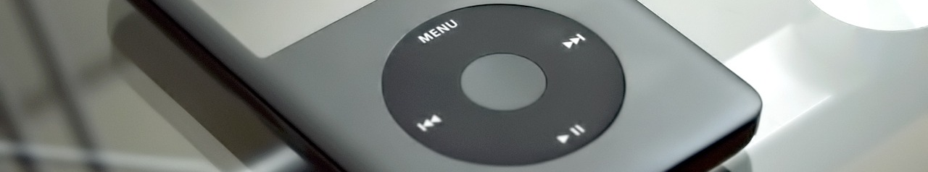
iPod
+
broadcast
Podcast
=

Slide 7
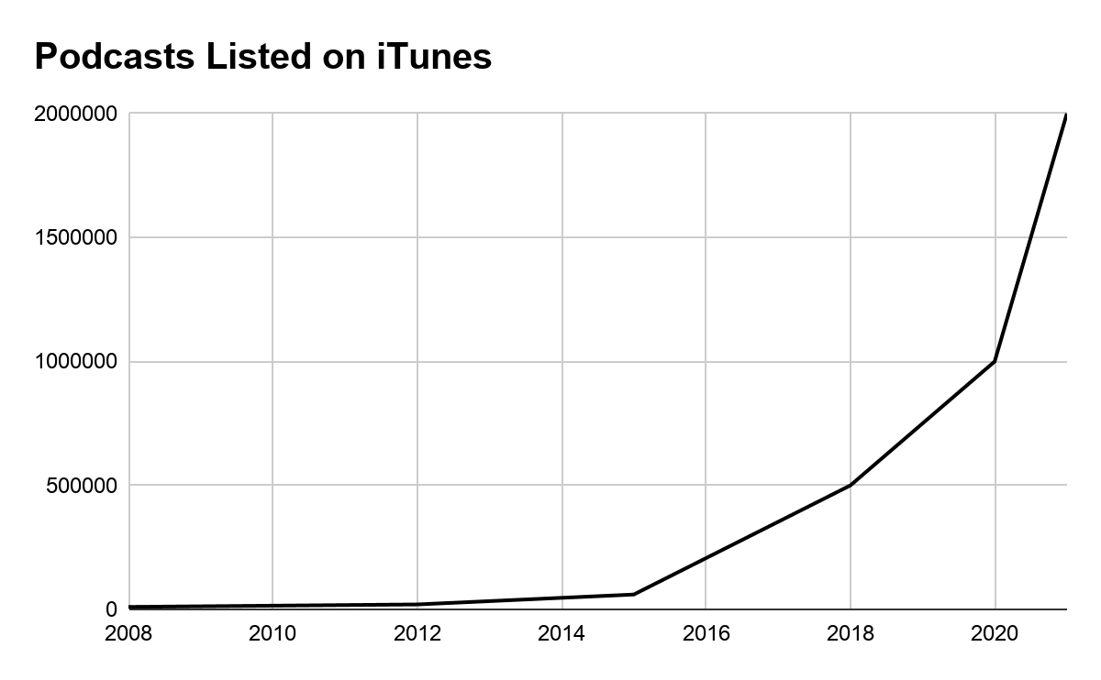
Podcast growth
There were 10,000 podcasts on iTunes in 2008. There were around 2 million in 2021. ¹
In Canada: ²
63% familiar with the term “podcast”
36% have listened to a podcast in the past month
[1] https://www.podcastinsights.com/podcast-statistics/
[2] https://podcasthosting.org/podcast-statistics/

Slide 8

Planning Your Podcast

Slide 9

Choose A Topic
Interesting
Focused and well-defined
Broad enough that you don’t run out of things to say!

Slide 10





Decide On Your Format
How many hosts?
How frequent?
Guests?
Length of show?
How many segments?

Slide 11



Equipment
Computer
Recording, editing, posting
Software
Audacity is free and easy to use
Microphone
Very important for sound quality

Slide 12

Recording Your Show

Slide 13

Preparation
Practice using your equipment
Make an outline for the episode
Write scripts for intros/outros

Slide 14

Record your show
Pick a quiet place to record
Avoid small rooms with flat uncovered walls
Don’t worry about making mistakes - you can edit them out later
Save your work!

Slide 15

Editing
Cut out filler words (“um”, “uh”), awkward silences, pointless digressions

Slide 16
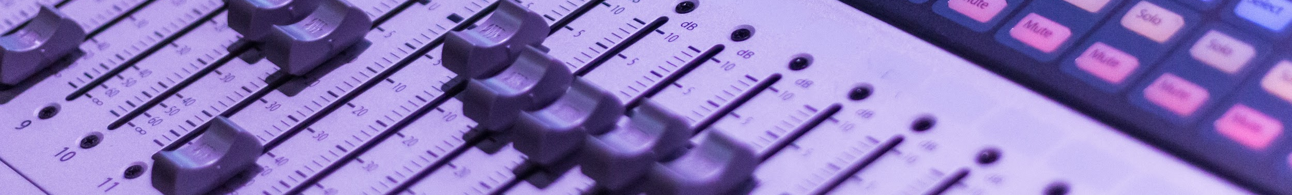
Production
Use equalization (EQ) to filter out low frequencies
Use compression to even out the volume
If you have music, mix it in where you want it in the show

Slide 17
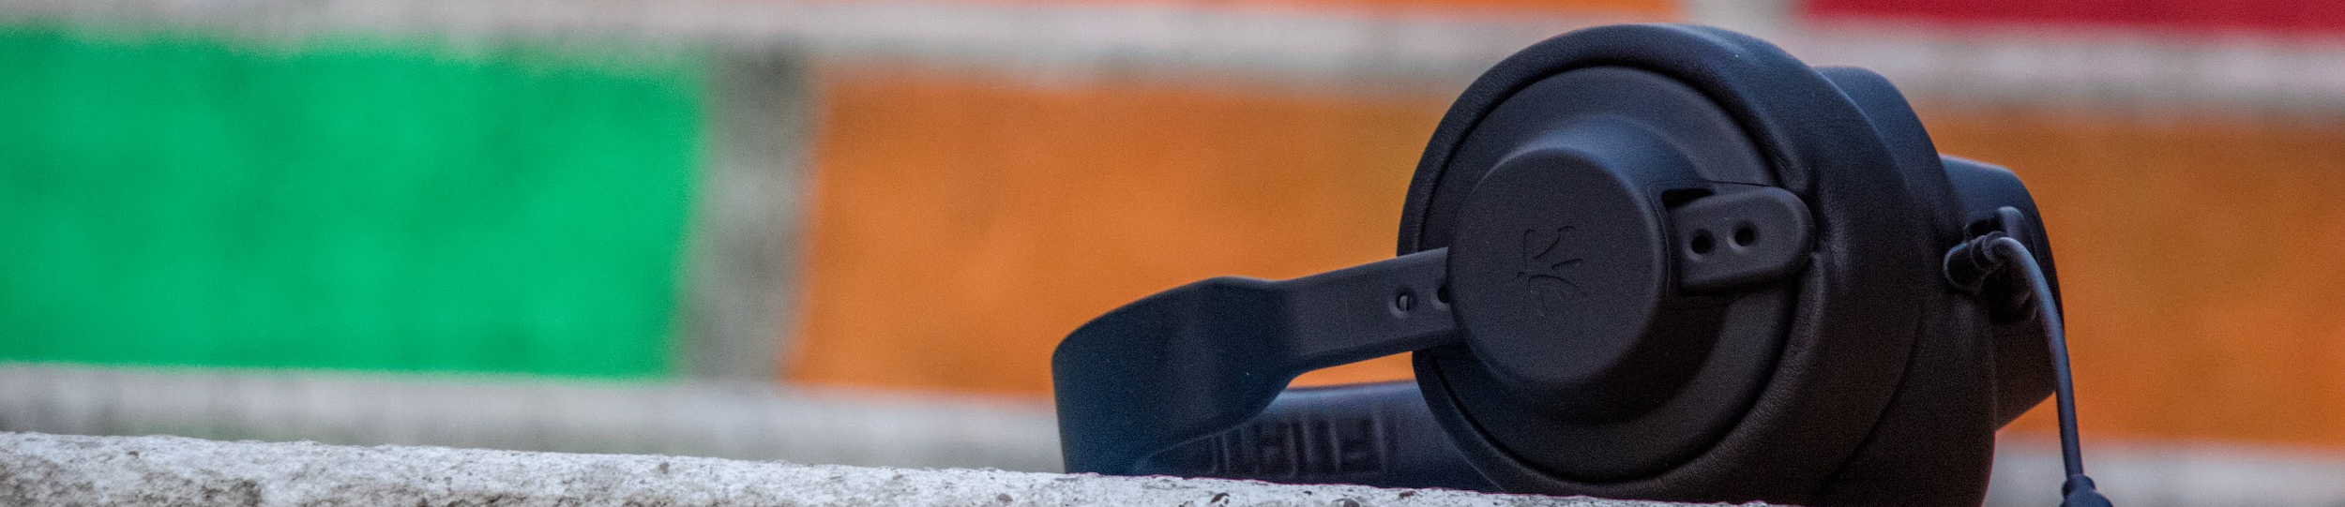
Your final product should be an mp3 file
Use a program like mp3tag to add metadata to your mp3

Slide 18

Show
Notes

Slide 19

Show Notes
Good show notes can draw in new listeners - they can find your show by searching for topics you are talking about

Slide 20

Hosting your podcast

Slide 21

Specialized podcast hosts
Popular services include Libsyn, Blubrry, Podbean
Hosting is tailored to podcasters needs
Various plans available, from $5/month and up
Higher-tier plans usually provide better statistics, more bandwidth and storage
If you’re planning to monetize your show, likely the best option

Slide 22
Self-hosting your podcast
ie. set up your own website and use (for example) Wordpress.org and some plugins to host your podcast
More flexibility than specialized podcast hosting
More technical know-how required
Costs vary depending on your web hosting service
Unless you’re using a specialized stats plugin, interpreting download stats is not straightforward

Slide 23
Free hosting
It is possible to host a podcast for free
You need either:
A free blog service
Blogger, Wordpress.com
Place to host mp3 files
Google Drive, Internet Archive
A service to produce your RSS feed
Feedburner
Or:
A free podcast hosting service
ACast, Spotify for Podcasters
Things to keep in mind:
Free podcast hosting services often have limits and offerings may change over time
Download speeds for your listeners are often slower
Statistics vary from non-existent to pretty good.
Monetization options for free podcast hosting services have improved over the years – read terms of service carefully when signing up.

Slide 24

Promoting
Your
Show!

Slide 25
Cover image
1400 px
This is the image people see in their podcast apps when they’re looking for shows
First impressions count!
Should be a jpeg or png file
Dimensions should be at least 1400 x 1400 px, up to 3000 x 3000 px
Awesome
Podcast!
1400 px

Slide 26

Podcast directories
Before you can submit your podcast, you need to post at least one episode to your feed!
Major directories:
Apple Podcasts (aka iTunes)
Spotify
Plus many smaller directories

Slide 27

Post updates to social media
Having a social media presence gives your listeners a way to interact with you
Posting short clips to Tiktok, Instagram, or YouTube Shorts may attract more listeners

Slide 28

Questions?
Comments?

